Slide 1

DBMS
Database Management Systems

Slide 2
What is Database?
Database is a collection of related data and data is a collection of facts and figures that can be processed to produce information.
Mostly data represents recordable facts. Data aids in producing information, which is based on facts. For example, if we have data about marks obtained by all students, we can then conclude about toppers and average marks.

Slide 3
Database Management Systems
A database management system stores data in such a way that it becomes easier to retrieve, manipulate, and produce information.

Slide 4
Database Management Systems
Database Management System (DBMS) is a software for storing and retrieving users' data while considering appropriate security measures. It consists of a group of programs which manipulate the database. The DBMS accepts the request for data from an application and instructs the operating system to provide the specific data. In large systems, a DBMS helps users and other third-party software to store and retrieve data.
.

Slide 5
Database Management Systems
DBMS allows users to create their own databases as per their requirement. The term “DBMS” includes the user of the database and other application programs. It provides an interface between the data and the software application

Slide 6
Example of a DBMS
Let us see a simple example of a university database.
This database is maintaining information concerning students, courses, and grades in a university environment. The database is organized as five files:
The STUDENT file stores data of each student
The COURSE file stores contain data on each course.
The SECTION stores the information about sections in a particular course.
The GRADE file stores the grades which students receive in the various sections
The TUTOR file contains information about each professor.

Slide 7
Example of a DBMS
To define a database system:
We need to specify the structure of the records of each file by defining the different types of data elements to be stored in each record.
We can also use a coding scheme to represent the values of a data item.
Basically, your Database will have 5 tables with a foreign key defined amongst the various tables.

Slide 8
History of DBMS
Here, are the important landmarks from the history:
1960 - Charles Bachman designed first DBMS system
1970 - Codd introduced IBM'S Information Management System (IMS)
1976- Peter Chen coined and defined the Entity-relationship model also know as the ER model
1980 - Relational Model becomes a widely accepted database component
1985- Object-oriented DBMS develops.

Slide 9
History of DBMS
1990s- Incorporation of object-orientation in relational DBMS.
1991- Microsoft ships MS access, a personal DBMS and that displaces all other personal DBMS products.
1995: First Internet database applications
1997: XML applied to database processing. Many vendors begin to integrate XML into DBMS products.

Slide 10
Characteristics of DBMS
A modern DBMS has the following characteristics −
Real-world entity − A modern DBMS is more realistic and uses real-world entities to design its architecture. It uses the behavior and attributes too. For example, a school database may use students as an entity and their age as an attribute.

Slide 11
Characteristics of DBMS
Relation-based tables − DBMS allows entities and relations among them to form tables. A user can understand the architecture of a database just by looking at the table names

Slide 12
Characteristics of DBMS
Isolation of data and application − A database system is entirely different than its data. A database is an active entity, whereas data is said to be passive, on which the database works and organizes. DBMS also stores metadata, which is data about data, to ease its own process.

Slide 13
Characteristics of DBMS
Less redundancy − DBMS follows the rules of normalization, which splits a relation when any of its attributes is having redundancy in values. Normalization is a mathematically rich and scientific process that reduces data redundancy.

Slide 14
Characteristics of DBMS
Consistency − Consistency is a state where every relation in a database remains consistent. There exist methods and techniques, which can detect attempt of leaving database in inconsistent state. A DBMS can provide greater consistency as compared to earlier forms of data storing applications like file-processing systems.

Slide 15
Characteristics of DBMS
ACID Properties − DBMS follows the concepts of Atomicity, Consistency, Isolation, and Durability (normally shortened as ACID). These concepts are applied on transactions, which manipulate data in a database. ACID properties help the database stay healthy in multi-transactional environments and in case of failure.

Slide 16
Characteristics of DBMS
Multiuser and Concurrent Access − DBMS supports multi-user environment and allows them to access and manipulate data in parallel.
Multiple views − DBMS offers multiple views for different users. A user who is in the Sales department will have a different view of database than a person working in the Production department.

Slide 17
Characteristics of DBMS
Security − Features like multiple views offer security to some extent where users are unable to access data of other users and departments. DBMS offers methods to impose constraints while entering data into the database and retrieving the same at a later stage. DBMS offers many different levels of security features, which enables multiple users to have different views with different features. For example, a user in the Sales department cannot see the data that belongs to the Purchase department.

Slide 18
DBMS vs. Flat File
DBMS | Flat File Management System
Multi-user access | It does not support multi-user access
Design to fulfill the need for small and large businesses | It is only limited to smaller DBMS system.
Remove redundancy and Integrity | Redundancy and Integrity issues
Expensive. But in the long term Total Cost of Ownership is cheap | It's cheaper
Easy to implement complicated transactions | No support for complicated transactions

Slide 19
Users in a DBMS environment
Component Name | Task
Application Programmers | The Application programmers write programs in various programming languages to interact with databases.

Slide 20
Users in a DBMS environment
Database Administrators | Database Admin is responsible for managing the entire DBMS system. He/She is called Database admin or DBA.
End-Users | The end users are the people who interact with the database management system. They conduct various operations on database like retrieving, updating, deleting, etc.

Slide 21
Popular DBMS Software
Here, is the list of some popular DBMS system:
MySQL
Microsoft Access
Oracle
PostgreSQL
dBASE
FoxPro
SQLite
IBM DB2
LibreOffice Base
MariaDB
Microsoft SQL Server etc.

Slide 22
Application of DBMS
Sector | Use of DBMS
Banking | For customer information, account activities, payments, deposits, loans, etc.
Airlines | For reservations and schedule information.
Universities | For student information, course registrations, colleges and grades.
Telecommunication | It helps to keep call records, monthly bills, maintaining balances, etc.
Finance | For storing information about stock, sales, and purchases of financial instruments like stocks and bonds.
Sales | Use for storing customer, product & sales information.
Manufacturing | It is used for the management of supply chain and for tracking production of items. Inventories status in warehouses.
HR Management | For information about employees, salaries, payroll, deduction, generation of paychecks, etc.

Slide 23
Advantages of DBMS
DBMS offers a variety of techniques to store & retrieve data
DBMS serves as an efficient handler to balance the needs of multiple applications using the same data
Uniform administration procedures for data
Application programmers never exposed to details of data representation and storage.
A DBMS uses various powerful functions to store and retrieve data efficiently.
Offers Data Integrity and Security
The DBMS implies integrity constraints to get a high level of protection against prohibited access to data.
A DBMS schedules concurrent access to the data in such a manner that only one user can access the same data at a time
Reduced Application Development Time

Slide 24
Advantages of DBMS
The DBMS implies integrity constraints to get a high level of protection against prohibited access to data.
A DBMS schedules concurrent access to the data in such a manner that only one user can access the same data at a time
Reduced Application Development Time

Slide 25
Disadvantage of DBMS
DBMS may offer plenty of advantages but, it has certain flaws-
Cost of Hardware and Software of a DBMS is quite high which increases the budget of your organization.
Most database management systems are often complex systems, so the training for users to use the DBMS is required.
In some organizations, all data is integrated into a single database which can be damaged because of electric failure or database is corrupted on the storage media
Use of the same program at a time by many users sometimes lead to the loss of some data.
DBMS can't perform sophisticated calculations.

Slide 26
When not to use a DBMS system?
Although, DBMS system is useful. It is still not suited for specific task mentioned below:
Not recommended when you do not have the budget or the expertise to operate a DBMS. In such cases, Excel/CSV/Flat Files could do just fine.

Slide 27
DBMS - Architecture
The design of a DBMS depends on its architecture. It can be centralized or decentralized or hierarchical. The architecture of a DBMS can be seen as either single tier or multi-tier. An n-tier architecture divides the whole system into related but independent n modules, which can be independently modified, altered, changed, or replaced.

Slide 28
DBMS - Architecture
In 1-tier architecture, the DBMS is the only entity where the user directly sits on the DBMS and uses it. Any changes done here will directly be done on the DBMS itself. It does not provide handy tools for end-users. Database designers and programmers normally prefer to use single-tier architecture.

Slide 29
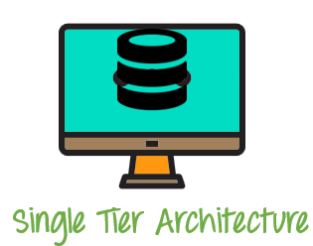
1-tier Architecture

Slide 30
DBMS - Architecture
If the architecture of DBMS is 2-tier, then it must have an application through which the DBMS can be accessed. Programmers use 2-tier architecture where they access the DBMS by means of an application. Here the application tier is entirely independent of the database in terms of operation, design, and programming.

Slide 31
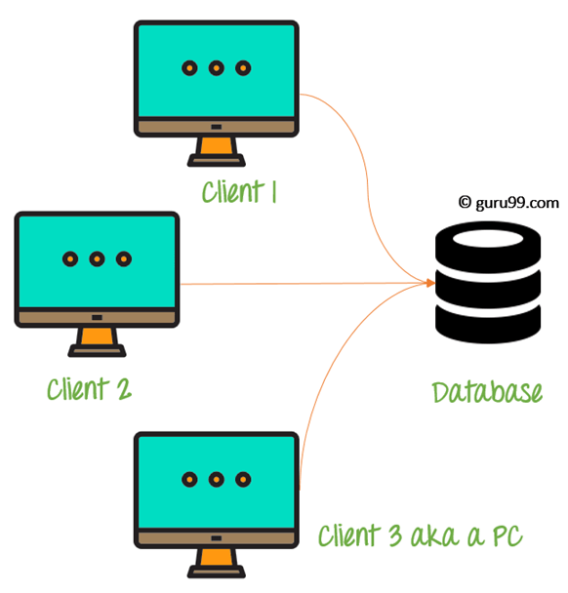
2-tier Architecture

Slide 32
DBMS - Architecture
3-tier Architecture
A 3-tier architecture separates its tiers from each other based on the complexity of the users and how they use the data present in the database. It is the most widely used architecture to design a DBMS.

Slide 33
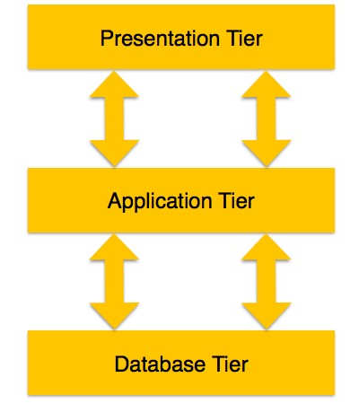
DBMS - Architecture

Slide 34
DBMS - Architecture
Database (Data) Tier − At this tier, the database resides along with its query processing languages. We also have the relations that define the data and their constraints at this level.
Application (Middle) Tier − At this tier reside the application server and the programs that access the database. For a user, this application tier presents an abstracted view of the database.

Slide 35
DBMS - Architecture
End-users are unaware of any existence of the database beyond the application. At the other end, the database tier is not aware of any other user beyond the application tier. Hence, the application layer sits in the middle and acts as a mediator between the end-user and the database.

Slide 36
DBMS - Architecture
User (Presentation) Tier − End-users operate on this tier and they know nothing about any existence of the database beyond this layer. At this layer, multiple views of the database can be provided by the application. All views are generated by applications that reside in the application tier.

Slide 37
DBMS - Data Schemas
A database schema is the skeleton structure that represents the logical view of the entire database. It defines how the data is organized and how the relations among them are associated. It formulates all the constraints that are to be applied on the data.

Slide 38
DBMS - Data Schemas
A database schema defines its entities and the relationship among them. It contains a descriptive detail of the database, which can be depicted by means of schema diagrams. It’s the database designers who design the schema to help programmers understand the database and make it useful.

Slide 39
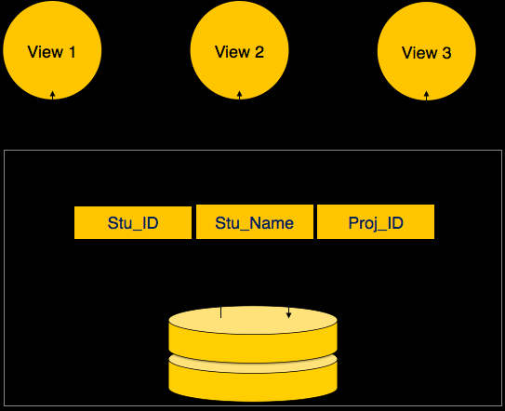
DBMS - Data Schemas

Slide 40
DBMS - Data Schemas
Internal Level/Schema
The internal schema defines the physical storage structure of the database. The internal schema is a very low-level representation of the entire database. It contains multiple occurrences of multiple types of internal record. In the ANSI term, it is also called "stored record'.

Slide 41
DBMS - Data Schemas
The internal schema is the lowest level of data abstraction
It helps you to keeps information about the actual representation of the entire database. Like the actual storage of the data on the disk in the form of records
The internal view tells us what data is stored in the database and how
It never deals with the physical devices. Instead, internal schema views a physical device as a collection of physical pages

Slide 42
DBMS - Data Schemas
A database schema can be divided broadly into two categories −
Physical Database Schema − This schema pertains to the actual storage of data and its form of storage like files, indices, etc. It defines how the data will be stored in a secondary storage.
Logical Database Schema − This schema defines all the logical constraints that need to be applied on the data stored. It defines tables, views, and integrity constraints.

Slide 43
DBMS - Data Schemas
Conceptual Schema/Level
The conceptual schema describes the Database structure of the whole database for the community of users. This schema hides information about the physical storage structures and focuses on describing data types, entities, relationships, etc.
This logical level comes between the user level and physical storage view. However, there is only single conceptual view of a single database.

Slide 44
DBMS - Data Schemas
Conceptual Schema/Level
Defines all database entities, their attributes, and their relationships
Security and integrity information
In the conceptual level, the data available to a user must be contained in or derivable from the physical level

Slide 45
DBMS - Data Schemas
External Schema/Level
An external schema describes the part of the database which specific user is interested in. It hides the unrelated details of the database from the user. There may be "n" number of external views for each database.
Each external view is defined using an external schema, which consists of definitions of various types of external record of that specific view.

Slide 46
DBMS - Data Schemas
External Schema/Level
An external level is only related to the data which is viewed by specific end users.
This level includes some external schemas.
External schema level is nearest to the user
The external schema describes the segment of the database which is needed for a certain user group and hides the remaining details from the database from the specific user group

Slide 47
Goal of 3 level/schema of Database
Every user should be able to access the same data but able to see a customized view of the data.
The user need not to deal directly with physical database storage detail.
The DBA should be able to change the database storage structure without disturbing the user's views
The internal structure of the database should remain unaffected when changes made to the physical aspects of storage.

Slide 48
DBMS - Data Independence
A database system normally contains a lot of data in addition to users’ data. For example, it stores data about data, known as metadata, to locate and retrieve data easily. It is rather difficult to modify or update a set of metadata once it is stored in the database. But as a DBMS expands, it needs to change over time to satisfy the requirements of the users. If the entire data is dependent, it would become a tedious and highly complex job.

Slide 49
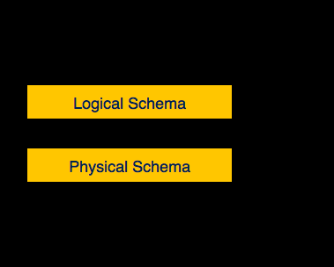
DBMS - Data Independence

Slide 50
DBMS - Data Independence
Metadata itself follows a layered architecture, so that when we change data at one layer, it does not affect the data at another level. This data is independent but mapped to each other.

Slide 51
DBMS - Data Independence
Logical Data Independence
Logical data is data about database, that is, it stores information about how data is managed inside. For example, a table (relation) stored in the database and all its constraints, applied on that relation.
Logical data independence is a kind of mechanism, which liberalizes itself from actual data stored on the disk. If we do some changes on table format, it should not change the data residing on the disk.

Slide 52
DBMS - Data Independence
Physical Data Independence
All the schemas are logical, and the actual data is stored in bit format on the disk. Physical data independence is the power to change the physical data without impacting the schema or logical data.
For example, in case we want to change or upgrade the storage system itself − suppose we want to replace hard-disks with SSD − it should not have any impact on the logical data or schemas.

Slide 53
Hierarchical Database Model
A hierarchical database model is a data model in which the data is organized into a tree-like structure. The data is stored as records which are connected to one another through links. A record is a collection of fields, with each field containing only one value. The entity type of a record defines which fields the record contains.

Slide 54
Hierarchical Database Model
The hierarchical database model mandates that each child record has only one parent, whereas each parent record can have one or more child records. In order to retrieve data from a hierarchical database the whole tree needs to be traversed starting from the root node. This model is recognized as the first database model created by IBM in the 1960s

Slide 55
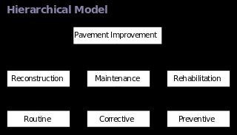
Hierarchical Database Model

Slide 56
Network model
The network model is a database model conceived as a flexible way of representing objects and their relationships. Its distinguishing feature is that the schema, viewed as a graph in which object types are nodes and relationship types are arcs, is not restricted to being a hierarchy or lattice.

Slide 57
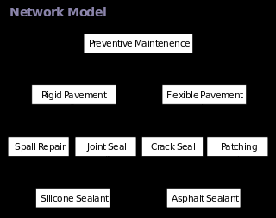
Network model

Slide 58
Relational DBMS
Relational data model is the primary data model, which is used widely around the world for data storage and processing. This model is simple and it has all the properties and capabilities required to process data with storage efficiency.

Slide 59
Object Relational DBMS
An object-relational database (ORD), or object-relational database management system (ORDBMS), is a database management system (DBMS) similar to a relational database, but with an object-oriented database model: objects, classes and inheritance are directly supported in database schemas and in the query language. In addition, just as with pure relational systems, it supports extension of the data model with custom data-types and methods.

Slide 60
Object Relational DBMS
The basic goal for the Object-relational database is to bridge the gap between relational databases and the object-oriented modeling techniques used in programming languages such as Java, C++, Visual Basic .NET or C#. However, a more popular alternative for achieving such a bridge is to use a standard relational database systems with some form of object-relational mapping (ORM) software. Whereas traditional RDBMS or SQL-DBMS products focused on the efficient management of data drawn from a limited set of data-types (defined by the relevant language standards), an object-relational DBMS allows software developers to integrate their own types and the methods that apply to them into the DBMS.

Slide 61
Object Relational DBMS
The ORDBMS (like ODBMS or OODBMS) is integrated with an object-oriented programming language. The characteristic properties of ORDBMS are 1) complex data, 2) type inheritance, and 3) object behavior. Complex data creation in most SQL ORDBMSs is based on preliminary schema definition via the user-defined type (UDT). Hierarchy within structured complex data offers an additional property, type inheritance. That is, a structured type can have subtypes that reuse all of its attributes and contain additional attributes specific to the subtype. Another advantage, the object behavior, is related with access to the program objects. Such program objects must be storable and transportable for database processing, therefore they usually are named as persistent objects. Inside a database, all the relations with a persistent program object are relations with its object identifier (OID). All of these points can be addressed in a proper relational system, although the SQL standard and its implementations impose arbitrary restrictions and additional complexity[

Slide 62
Object Relational DBMS
CREATE TABLE Customers ( Id Cust_Id NOT NULL PRIMARY KEY, Name PersonName NOT NULL, DOB DATE NOT NULL );
SELECT Formal( C.Id ) FROM Customers C WHERE BirthDay ( C.DOB ) = TODAY;

Slide 63
Introduction to MYSQL
MySQL is a fast, easy-to-use RDBMS being used for many small and big businesses. MySQL is developed, marketed, and supported by MySQL AB, which is a Swedish company.

Slide 64
Introduction to MYSQL
MySQL is becoming so popular because of many good reasons:
MySQL is released under an open-source license. So you have nothing to pay to use it.
MySQL is a very powerful program in its own right. It handles a large subset of the functionality of the most expensive and powerful database packages.
MySQL uses a standard form of the well-known SQL data language.
MySQL works on many operating systems and with many languages including PHP, PERL, C, C++, JAVA, etc

Slide 65
Introduction to MYSQL
MySQL works very quickly and works well even with large data sets.
MySQL is very friendly to PHP, the most appreciated language for web development.
MySQL supports large databases, up to 50 million rows or more in a table. The default file size limit for a table is 4GB, but you can increase this (if your operating system can handle it) to a theoretical limit of 8 million terabytes (TB).
MySQL is customizable. The open-source GPL license allows programmers to modify the MySQL software to fit their own specific environments.

Slide 66
Thank You

